Slide 1
Chapter 3: Differences, Consistency, and The Meaning of Test Scores

Slide 2
The Nature of Variability
All psychological measurement assumes that people differ!
  Inter-individual differences: difference between two people (usually fundamental differences)
  Intra-individual differences: difference in one person over time.
Purpose of quantifiable differences?
  To measure anything in psych, we need to be able to measure differences between people!
Notes:
Explicit and implicit cases:
Any psychological measurement rests upon the assumption that people differ from one another in their psychological characters or behavior.
However, in some cases, the assumption is explicit and, in some others, it is implicit.
Interindividual differences:
Interindividual differences is one of the two types of differences that behavioral scientists attempt to measure.
This refers to the differences that exist between people.
Interindividual differences can occur between people of the same group or different groups.
It is important to note that such “between-group” differences are fundamentally differences between people.
Intraindividual differences:
The second type of difference that behavioral scientist attempt to measure is intraindividual difference.
This refers to the differences that emerge in one person over time or under different circumstances.
Purpose of quantifiable differences: To be able to measure and use any parameter in psychology, it is important that psychological differences exist and be quantifiable.

Slide 3
Importance of Individual Differences (1 of 2)
Example: Why are some people more aggressive than others?
This question makes two assumptions:
  1. Aggression can be measured
  2. People vary on aggression
Notes:
Significance of variability:
Behavioral sciences are all about understanding the differences between people in the same as well as in different groups.
Measuring these differences is an essential part of the sciences.
In other words, variability lies at the crux of research and its applications in the behavioral sciences.
Rise of questions and its reasons:
Consider psychologists who study various phenomena such as intelligence, aggression, marital happiness, and so on.
Based on their area of study, questions arise. Example: Why are some people more aggressive than others?
The reason behind such questions is the assumption that people differ in behavior from one another and that difference is measurable.
Application of variability:
The variability or the assumed difference in psychological characteristics between individuals can be applied to many cases.
For example, employers attempt to detect variability in integrity and clinicians attempt to detect variability in various psychological disorders.
A common, incorrect view:
Generally, individual differences are often considered as a concern only for those who construct and use traditional psychological tests.
This view limits the relevance of psychometrics and is an incorrect one too.
In fact, all research in psychology and all scientific applications of psychology depend on the ability to measure individual differences.

Slide 4
Importance of Individual Differences (2 of 2)
Not just “traditional” testing!
  Example: Cognitive psych – differences in memory capacity, attention, comprehension, etc.
Steps to quantify individual differences
  1. Assume scores vary from person to person (a distribution)
  2. Variability == differences between scores
  3. Decide how to determine the amount of variability
Notes:
Measurable individual differences:
In any case that involves scientific application of psychology, it is required that individual differences be measured.
For instance, clinical analysis that involves diagnosis of psychological pathology, the clinician measures the changes in behavior over time between different groups of people and links the change to therapy.
The point to be emphasized is that any domain of scientific psychology—experimental or nonexperimental, basic or applied—depends on the existence and quantification of individual differences.
Steps to quantify individual differences:
The first step to quantify individual differences is to assume that scores from a test will vary from one person to another.
The set of test scores obtained from many individuals or from a single individual at different time points is called distribution of scores.
The difference among these scores is the variability.
Determining the amount of variability within distribution of scores is the key here.

Slide 5
Variability and Distributions of Scores (1 of 6)
Variance == Statistical method of quantifying variability in a single distribution
Covariance == How does the variability in one set of scores compare to the variability in a second?
Notes:
Understanding the concept of variance and covariance:
It is important to understand variance and covariance and how they are computed, in order to understand key concepts in psychometrics.
Variance refers to the statistical way of quantifying variability in a distribution or set of scores.
Covariance is about quantifying the connection between variability in one set of scores and variability in another set of scores.
Detection and description of scores:
When a group of people take a psychological test, each person gets a score.
The detection of distribution of test scores is thus done.
To be able to describe a distribution of scores in a meaningful way is the key goal of statistics.

Slide 6
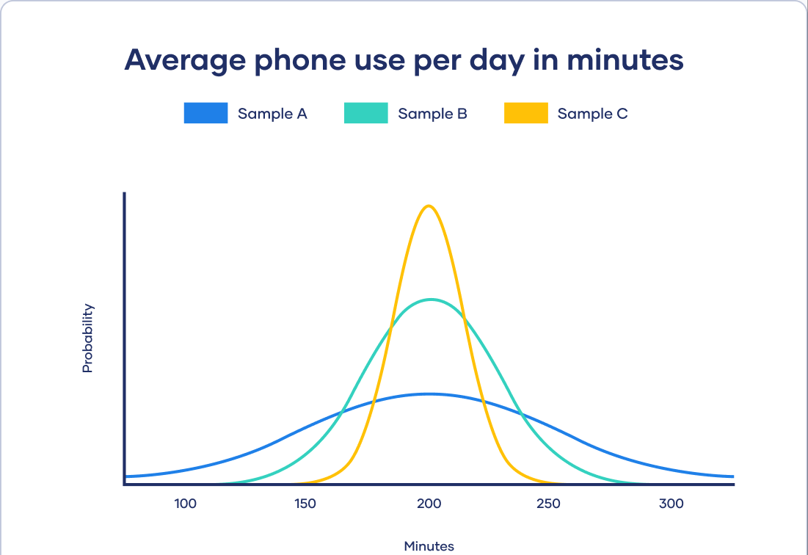

Slide 7
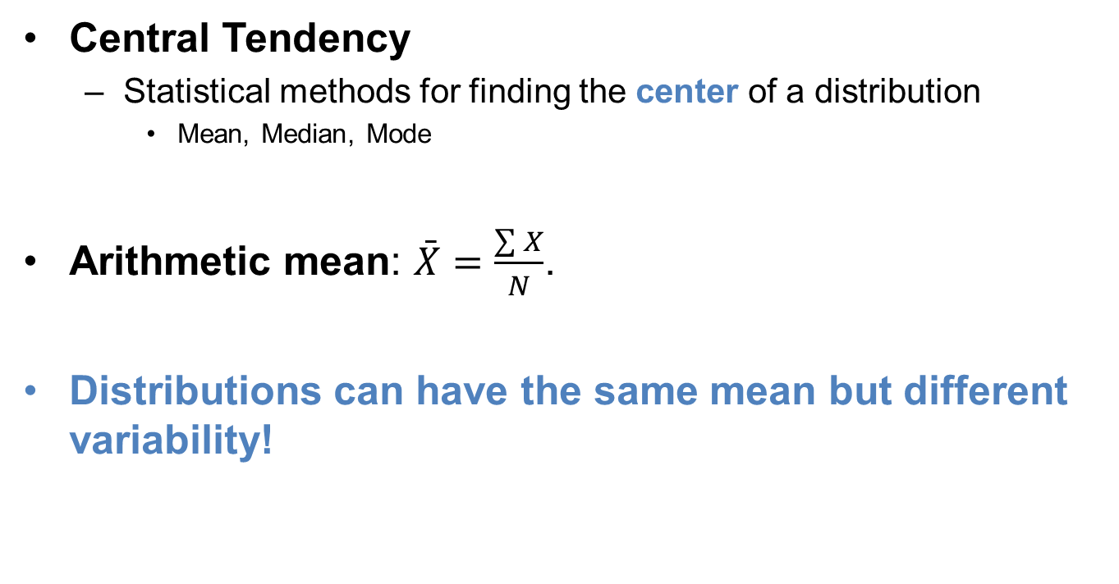
Variability and Distributions of Scores (2 of 6)
Central Tendency
  Statistical methods for finding the center of a distribution
    Mean, Median, Mode
Arithmetic mean: $\bar{X}=\frac{\sum{X}}{N}$.
Distributions can have the same mean but different variability!
Notes:
Statistical values to reflect central tendency:
Central tendency which represents the score that is most representative of the entire distribution is the most basic facet of a distribution of scores.
Statistical values such as mean, median, mode can be used to reflect central tendency and mean is considered the most important of them all.
Arithmetic mean:
Arithmetic mean $\left(\bar{X}\right)$ can be computed using the formula: $Mean=\bar{X}=\frac{\sum{X}}{N}$.
In the above equation, the sigma (Σ) symbol along with the X represents the sum the X values and N represents the total number of X values in the distribution.
Need to quantify the difference:
Computing the arithmetic mean is useful.
Nevertheless, researchers are interested in variability.
This can be done by quantifying the degree of deviation from the group mean.

Slide 9
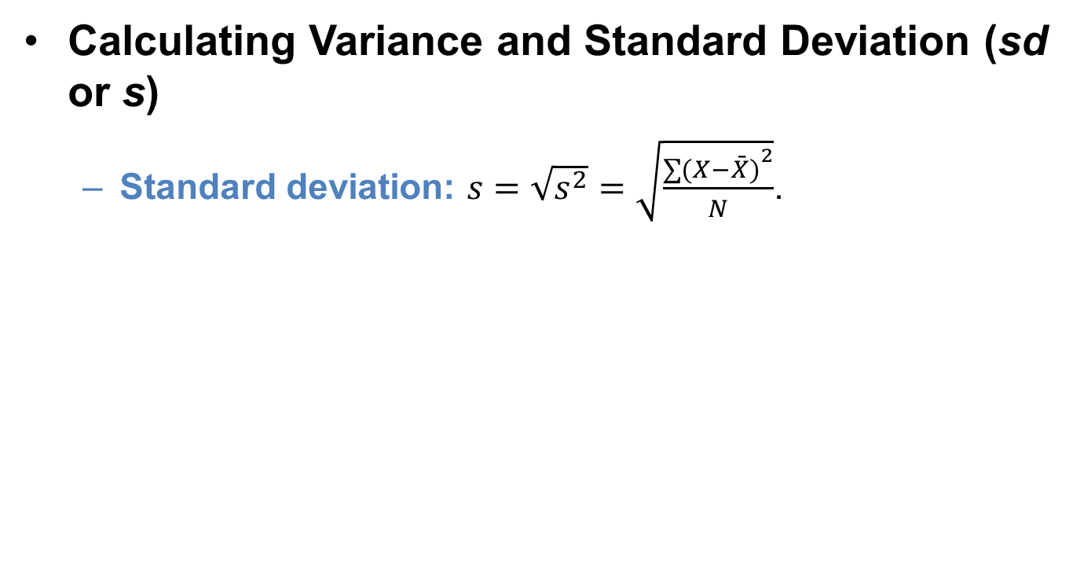
Variability and Distributions of Scores (3 of 6)
Calculating Variance and Standard Deviation (sd or s)
  Standard deviation: $s=\sqrt{s^{2}}=\sqrt{\frac{{\sum{(X−\bar{X})}}^{2}}{N}}$.
Notes:
Purpose of multiple statistical values:
For measurements to be useful, they must be sensitive to psychological variability.
Therefore, the amount of variability within a distribution of scores must be quantifiable.
This can be done using multiple statistical values and the most important ones to be focused upon are variance and standard deviation.
Variance and standard deviation reflect variability as the degree to which the scores in a distribution deviate differ from the mean of the distribution.
Steps to compute the variance:
Calculation of variance can be summarized into three main steps.
First, the deviation of each score from the mean is calculated. This is represented as $\left(X−\bar{X}\right)$ for each score.
Second, the square of each deviation is calculated, that is, ${\left(X−\bar{X}\right)}^{2}$.
Third, the mean of these squared deviations is calculated.
Variance can therefore be referred to as mean of squared deviation scores that gives the average degree to which people differ from each other.
Standard deviation: It is closely related to variance and is calculated using the formula $s=\sqrt{s^{2}}=\sqrt{\frac{{\sum{(X−\bar{X})}}^{2}}{N}}$.
Variance versus standard deviation:
Standard deviation reflects variability in terms of the size of raw deviation scores.
Since variance reflects variability in terms of squared deviation scores, standard deviation is considered as more intuitive.
Interpretation of both concepts, however, is not always clear.

Slide 10
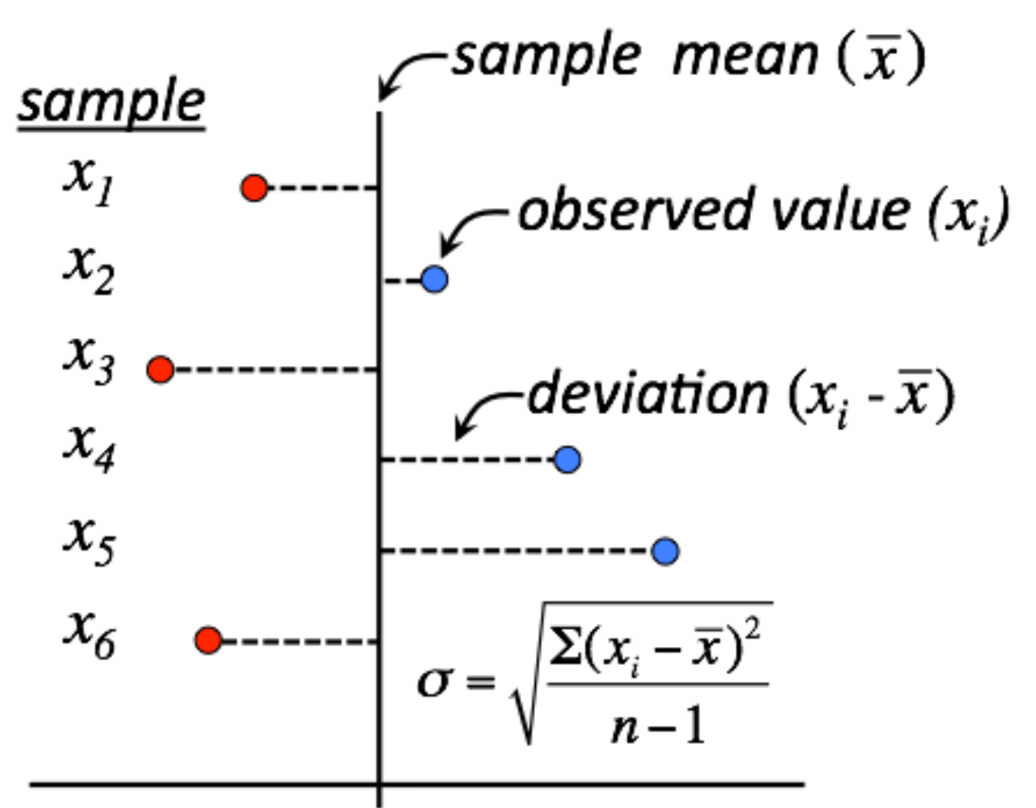

$$\sum{(X−\bar{X})}$$
Notes:
Purpose of multiple statistical values:
For measurements to be useful, they must be sensitive to psychological variability.
Therefore, the amount of variability within a distribution of scores must be quantifiable.
This can be done using multiple statistical values and the most important ones to be focused upon are variance and standard deviation.
Variance and standard deviation reflect variability as the degree to which the scores in a distribution deviate differ from the mean of the distribution.
Steps to compute the variance:
Calculation of variance can be summarized into three main steps.
First, the deviation of each score from the mean is calculated. This is represented as $\left(X−\bar{X}\right)$ for each score.
Second, the square of each deviation is calculated, that is, ${\left(X−\bar{X}\right)}^{2}$.
Third, the mean of these squared deviations is calculated.
Variance can therefore be referred to as mean of squared deviation scores that gives the average degree to which people differ from each other.
Standard deviation: It is closely related to variance and is calculated using the formula $s=\sqrt{s^{2}}=\sqrt{\frac{{\sum{(X−\bar{X})}}^{2}}{N}}$.
Variance versus standard deviation:
Standard deviation reflects variability in terms of the size of raw deviation scores.
Since variance reflects variability in terms of squared deviation scores, standard deviation is considered as more intuitive.
Interpretation of both concepts, however, is not always clear.

Slide 11

Negative
Positive
$$\sum{(X−\bar{X})}$$
$$\sqrt{\frac{{\sum{(X−\bar{X})}}^{2}}{N}}$$
Notes:
Purpose of multiple statistical values:
For measurements to be useful, they must be sensitive to psychological variability.
Therefore, the amount of variability within a distribution of scores must be quantifiable.
This can be done using multiple statistical values and the most important ones to be focused upon are variance and standard deviation.
Variance and standard deviation reflect variability as the degree to which the scores in a distribution deviate differ from the mean of the distribution.
Steps to compute the variance:
Calculation of variance can be summarized into three main steps.
First, the deviation of each score from the mean is calculated. This is represented as $\left(X−\bar{X}\right)$ for each score.
Second, the square of each deviation is calculated, that is, ${\left(X−\bar{X}\right)}^{2}$.
Third, the mean of these squared deviations is calculated.
Variance can therefore be referred to as mean of squared deviation scores that gives the average degree to which people differ from each other.
Standard deviation: It is closely related to variance and is calculated using the formula $s=\sqrt{s^{2}}=\sqrt{\frac{{\sum{(X−\bar{X})}}^{2}}{N}}$.
Variance versus standard deviation:
Standard deviation reflects variability in terms of the size of raw deviation scores.
Since variance reflects variability in terms of squared deviation scores, standard deviation is considered as more intuitive.
Interpretation of both concepts, however, is not always clear.

Slide 12
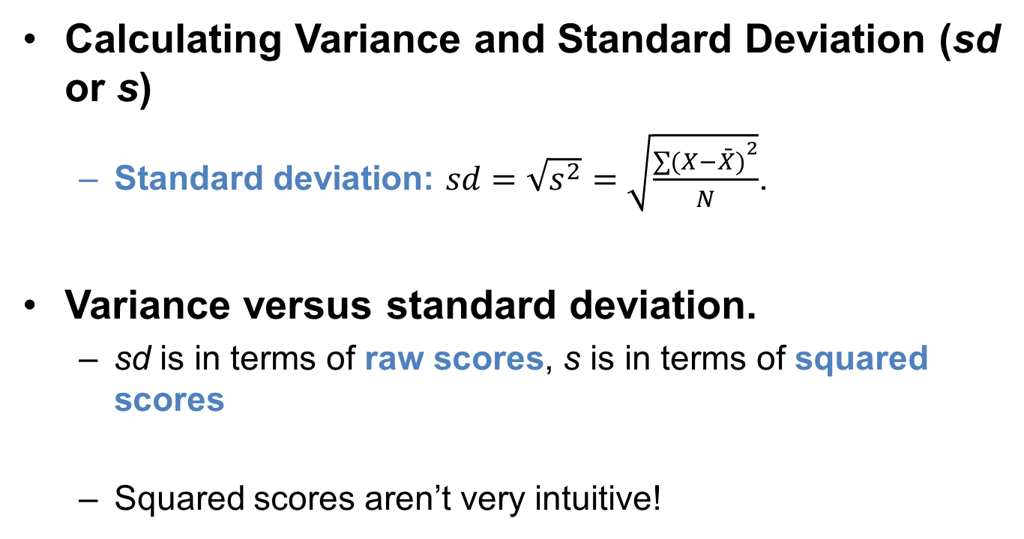
Variability and Distributions of Scores (3 of 6)
Calculating Variance and Standard Deviation (sd or s)
  Standard deviation: $sd=\sqrt{s^{2}}=\sqrt{\frac{{\sum{(X−\bar{X})}}^{2}}{N}}$.
Variance versus standard deviation.
  sd is in terms of raw scores, s is in terms of squared scores
  Squared scores aren’t very intuitive!
Notes:
Purpose of multiple statistical values:
For measurements to be useful, they must be sensitive to psychological variability.
Therefore, the amount of variability within a distribution of scores must be quantifiable.
This can be done using multiple statistical values and the most important ones to be focused upon are variance and standard deviation.
Variance and standard deviation reflect variability as the degree to which the scores in a distribution deviate differ from the mean of the distribution.
Steps to compute the variance:
Calculation of variance can be summarized into three main steps.
First, the deviation of each score from the mean is calculated. This is represented as $\left(X−\bar{X}\right)$ for each score.
Second, the square of each deviation is calculated, that is, ${\left(X−\bar{X}\right)}^{2}$.
Third, the mean of these squared deviations is calculated.
Variance can therefore be referred to as mean of squared deviation scores that gives the average degree to which people differ from each other.
Standard deviation: It is closely related to variance and is calculated using the formula $s=\sqrt{s^{2}}=\sqrt{\frac{{\sum{(X−\bar{X})}}^{2}}{N}}$.
Variance versus standard deviation:
Standard deviation reflects variability in terms of the size of raw deviation scores.
Since variance reflects variability in terms of squared deviation scores, standard deviation is considered as more intuitive.
Interpretation of both concepts, however, is not always clear.

Slide 13
Variability and Distributions of Scores (4 of 6)
Two factors used to determine size of variance.
  Degree to which scores differ in a distribution.
    Raw distance between scores
  Metric of the scores in the distribution.
    Scores on a 0 – 100 test vs. GPA values (0 – 4.0)
Notes:
Two factors used to determine size of variance:
The first factor is the degree to which the scores in a distribution differ from each other.
With all else being equal, for a distribution of scores, the smaller the deviation, the smaller the variance.
However, all is not always equal and therefore, we move on to another factor to determine variance size.
The second factor is the metric of the scores in the distribution.
The grade point average (GPA) values are used and these values range only between 0 and 4.0.
In the previous example, when variance of the IQ scores was computed to be s² = 166.67, the GPA scores would be only s² = 0.39.
This huge difference implies that there is a huge difference in the metrics of the two sets of scores.

Slide 14
Variability and Distributions of Scores (5 of 6)
Factors to consider while interpreting variance (or) standard deviation.
  sd and s² can never == 0 or be negative!
  Cannot be interpreted as small or large
  Needs context to be interpreted!
    Variability by itself is almost meaningless!
Notes:
Factors to be considered while interpreting variance (or) standard deviation:
Four factors play an important role while calculating the two indexes of variability.
First, variance as well as standard deviation can never be zero or less than zero.
Second, there is no simple way to to interpret a variance or standard deviation as large or small.
Third, the variance of a distribution of scores is most interpretable and meaningful when it is put in context.
Fourth, the importance of variance and standard deviation depends greatly on their impact on other values that are more directly interpretable.
Understanding crucial concepts:
Interpretations of variance and standard deviations just by themselves are generally not given much importance.
However, to understand other crucial concepts like correlations and reliability, one must be able to understand in depth what variance and standard deviation reflect.
Denominators in inferential statistics:
One may have noticed that the denominators in the calculation of variance is standard deviation is N – 1, instead of simply N.
The N – 1 versions are used only while computing inferential statistics.
Inferential statistics is particularly helpful when researchers make inferences from relatively small samples of people to much larger populations of people.
Nevertheless, the N – 1 and N versions do not individually change the essential interpretation of a variance or a standard deviation.

Slide 15
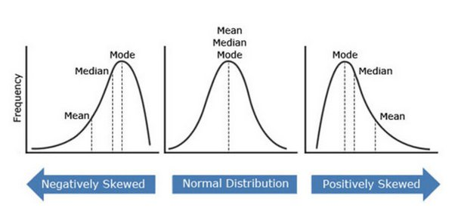
Variability and Distributions of Scores (6 of 6)
Distribution Shapes
Notes:
Graphical representation of a distribution:
A curve can be used to graphically represent a distribution.
Normal distribution is important because many statistical procedures can be applied onto distribution of scores only if they are normally distributed and because, sometimes the very meaning of test scores sometimes hinges on the assumption that the scores are normally distributed.
Normal distribution: a theoretical ideal:
In reality, distributions of scores are perfectly normal.
While real data cannot exactly be normally distributed, often they are close to a normal distribution and can be used as model for interpreting scores in a distribution of scores.
Skewed distribution:
A distribution that is not perfectly normal is skewed.
While a normal distribution has a skew value of 0, the shape of any distribution can be quantified in terms of its amount of skew.
Distributions with relatively few values above the mean are positively skewed (skew value greater than 0).
Distributions with relatively few values below the mean are negatively skewed (skew values below zero).
Skew value can be computed using $\text{Skew}=\frac{{\sum{\left(X−\bar{X}\right)}}^{3}}{Ns^{3}}$.

Slide 16
Quantifying the Association or Consistency between Distribution
(1 of 7)
Association: degree of variation between distributions.
Example: variability in IQ scores as well as GPAs among students.
Need of two variables at least.
Notes:
Association:
It refers to the degree to which two distributions of scores vary in a corresponding manner.
As important as variability is association (also referred to as consistency, or covariability) between two distributions.
Example: variability in IQ scores as well as GPAs among students:
When a group of students differ in their IQ scores as well as their GPAs, it may be interesting to find out the possibility that variability in IQ scores is associated with variability in GPA.
Questions pertaining to this association lie at the heart of psychometric theory and behavioral science.
Need of two variables at least:
To explore association between scores, each test participant must have scores on at least two variables.
In the above, each student has taken an IQ test and has earned a GPA thus letting us examine the association between IQ and GPA.
Following this, statistical values that reflect the degree to which the two variables are associated can be computed.

Slide 17
Quantifying the Association or Consistency between Distribution
(2 of 7)
Interpreting the Association between Two Variables
  Direction of the association.
  Magnitude of the association.
Concept of consistency.
  Are individual differences consistent across two variables?
  Example: Consistent changes in GPA as a function of classes missed
Weak associations == inconsistency.
  Example: Relationship shoe size and GPA
Notes:
Direction of the association:
To understand the association between two variables, we must know the direction of the association.
If high scores on one variable reflect as high scores on the other variable too, then the association is direct or positive.
If high scores on one variable translate into low scores for another, then the association is inverse or negative.
Magnitude of the association:
Magnitude helps us to understand the association between two variables by reflecting how strongly (or weakly) the two variables are associated with one another.
Extensive research in behavioral sciences have been dedicated to understanding the strength of association between important behavioral variables.
Concept of consistency:
We can interpret a strong association between two variables as showing that individual differences are consistent across the two variables.
For example, GPA scores and SAT scores would hold a strong positive association between them when differences in SAT scores are highly consistent with differences in GPA.
Similarly, number of class absences and GPA would hold a strong negative association as people who have missed a greater number of classes tend to score a relatively less GPA.
Weak associations and inconsistency:
When individual differences in one variable are totally inconsistent with individual differences in the other variable, the association between the variables is weak.
For instance, there is no association between shoe size and GPA as there is no consistent tendency to score higher with smaller or larger shoes.

Slide 18
Quantifying the Association or Consistency between Distribution
(3 of 7)
Variance == Single Distribution
Covariance == variability in two distributions
Information on direction and magnitude of association.
  Can tell the direction! (positive or negative)
  Not so good w/ magnitude
Notes:
Covariance:
Since psychometrics depends heavily on precise quantification of covariability, covariance, and correlation emerge as important statistical concepts.
Covariance builds a bridge between variability and an interpretable quantitative index of covariability.
Covariance is computed from the variability among scores in two different distributions, but variance is from a single distribution of scores.
Step in computing covariance:
The first step in computing covariance between two distributions is to calculate deviation scores.
The second step is calculation of “cross-products” of the deviation scores.
This is done by multiplying the two deviation scores for each individual.
The final step involves the calculation of mean of the cross-products.
The equation for covariance is derived as follows during this step.
$\text{Covariance} =c_{XY}=\frac{\sum{\left(X−\bar{X}\right)\left(Y−\bar{Y}\right)}}{N}$.
The trend of the cross-products (positive, negative, or equal to zero) is observed during this step.
Information on direction and magnitude of association:
Covariance offers clear information about the direction of the association.
However, the same cannot be said about the magnitude of the association.
Magnitude of covariance is affected by the strength of association and metrics of the two variables.

Slide 19
Quantifying the Association or Consistency between Distribution
(6 of 7)
Covariances is the basis for many statistical concepts (e.g., correlations, reliability estimates, etc.)
Downside: Alone it isn’t very useful
Notes:
Significance and downside of covariance:
Covariance is an important concept because it serves as a basis for many other important statistical concepts and procedures.
However, it has limited direct interpretability.
Variance–covariance matrix:
It is based on the analysis of sets of variances and covariances and is built using the values derived from these analyses.
The smallest possible type of variance–covariance matrix has only two variables, and it includes two variances and one covariance.
Properties of variance–covariance matrix:
A variance–covariance matrix has some standard properties:
First, each variable has a row and a column.
Second, the variances of the variables are presented in a diagonal starting from the upper left to the bottom right of the matrix.
Third, all cells other (than the diagonal ones) present covariances between pairs of variables.
The fourth property of the variance–covariance matrix is that the matrix is said to be symmetric when the values above and below the diagonal are identical.

Slide 20
Quantifying the Association or Consistency between Distribution
(7 of 7)
Correlation Coefficient (Pearson’s r)
Provides an easy interpretation of linear association
Ranges from -1 to +1
Pearson correlations are most common:
  Tetrachoric correlation == binary variables
  Spearman correlation for ordinal
Index of consistency
  Correlations are great for evaluating consistency!
  Do scores change together? If so, how and to what degree?
Notes:
Key features of correlation:
Correlation coefficient aim at offering an easily interpretable index of linear association.
Its value ranges from only from −1 to +1.
Their boundedness makes them easily interpretable than covariances.
Correlation coefficient clearly reflects the direction of the association between two variables (positive and negative association).
Correlation coefficient also reflects the magnitude of association between two variables, unlike covariance.
Its value is based partially on the covariance between the variables.
Correlation coefficient holds a “bounded” quality.
Formula and significance:
Correlation is calculated using the formula: $\text{Correlation}=r_{XY}=\frac{c_{XY}}{S_{X}S_{Y}}$.
Correlation coefficient is important because it plays a vital role in reliability theory, the estimation of reliability, the conceptual basis of validity, the estimation of validity, the effect of response biases on test scores, and the idea of test bias.
Different forms of correlation:
Pearson correlation is the best option for two variables that are on an interval or ratio scale of measurement.
However, there are other forms of correlation too.
For instance, tetrachoric correlation is best for pairs of binary variables. Then there is the Spearman correlation for pairs of ordinal variables.
Index of consistency:
Correlation is a way of evaluating the consistency of individual differences.
Based on the value of the correlation coefficient, the consistency can be positive, negative, or no consistency.

Slide 21
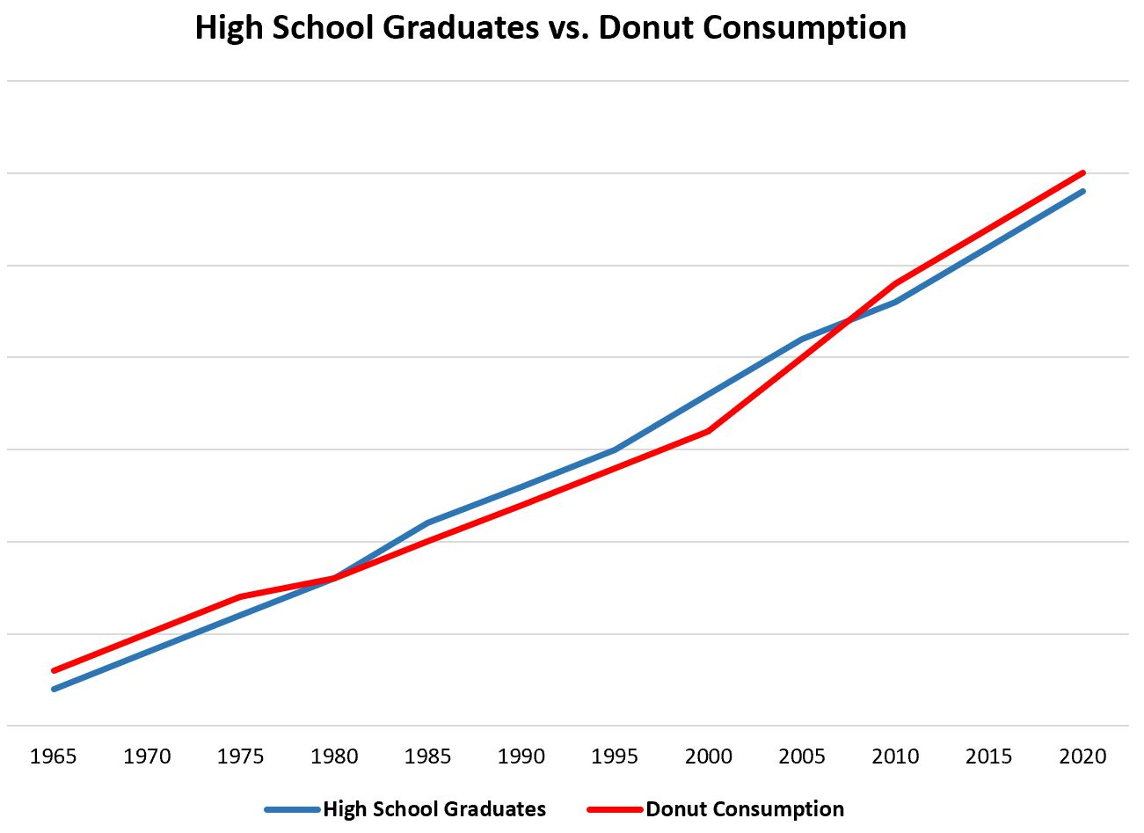
Correlations and Causation (1 of 2)
Can correlations be used to determine cause? Why or why not?
Notes:
Key features of correlation:
Correlation coefficient aim at offering an easily interpretable index of linear association.
Its value ranges from only from −1 to +1.
Their boundedness makes them easily interpretable than covariances.
Correlation coefficient clearly reflects the direction of the association between two variables (positive and negative association).
Correlation coefficient also reflects the magnitude of association between two variables, unlike covariance.
Its value is based partially on the covariance between the variables.
Correlation coefficient holds a “bounded” quality.
Formula and significance:
Correlation is calculated using the formula: $\text{Correlation}=r_{XY}=\frac{c_{XY}}{S_{X}S_{Y}}$.
Correlation coefficient is important because it plays a vital role in reliability theory, the estimation of reliability, the conceptual basis of validity, the estimation of validity, the effect of response biases on test scores, and the idea of test bias.
Different forms of correlation:
Pearson correlation is the best option for two variables that are on an interval or ratio scale of measurement.
However, there are other forms of correlation too.
For instance, tetrachoric correlation is best for pairs of binary variables. Then there is the Spearman correlation for pairs of ordinal variables.
Index of consistency:
Correlation is a way of evaluating the consistency of individual differences.
Based on the value of the correlation coefficient, the consistency can be positive, negative, or no consistency.

Slide 22

Correlations and Causation (2 of 2)
Can correlations be used to determine cause? Why or why not?
https://www.tylervigen.com/spurious-correlations
Notes:
Key features of correlation:
Correlation coefficient aim at offering an easily interpretable index of linear association.
Its value ranges from only from −1 to +1.
Their boundedness makes them easily interpretable than covariances.
Correlation coefficient clearly reflects the direction of the association between two variables (positive and negative association).
Correlation coefficient also reflects the magnitude of association between two variables, unlike covariance.
Its value is based partially on the covariance between the variables.
Correlation coefficient holds a “bounded” quality.
Formula and significance:
Correlation is calculated using the formula: $\text{Correlation}=r_{XY}=\frac{c_{XY}}{S_{X}S_{Y}}$.
Correlation coefficient is important because it plays a vital role in reliability theory, the estimation of reliability, the conceptual basis of validity, the estimation of validity, the effect of response biases on test scores, and the idea of test bias.
Different forms of correlation:
Pearson correlation is the best option for two variables that are on an interval or ratio scale of measurement.
However, there are other forms of correlation too.
For instance, tetrachoric correlation is best for pairs of binary variables. Then there is the Spearman correlation for pairs of ordinal variables.
Index of consistency:
Correlation is a way of evaluating the consistency of individual differences.
Based on the value of the correlation coefficient, the consistency can be positive, negative, or no consistency.

Slide 23
Partial Correlation (1 of 2)
Quantifies the degree of association between two variables after statistically removing the association of a third variable with both of those two variables.
Allows us to quantify the relation between two variables, controlling for the correlation of each of these variables with a third related variable.

Slide 24
Partial Correlation (2 of 2)
We can assess the correlation between number of absences and exam grade (A), over and above the correlation of percentage of completed homework assignments with these variables (B).

Slide 25
Variance and Covariance for “Composite Variables”
Participants usually complete several items on a scale
Composite scores == summed or average across items
Advantages of composite scores?
Notes:
Forming a composite score:
Most psychological tests involve recording responses from participants or observing their behavior.
Scores for each response or observation is determined and all scores are either summed or averaged to derive a composite score.
Example: Beck Depression Inventory II.
Computing the variance of composite scores:
Variance of composite scores can be calculated using the equation: $\text{Variance}=s^{2}=\frac{{\sum{\left(X−\bar{X}\right)}}^{2}}{N}$.
Nevertheless, it is essential to understand that the variance of the composite scores is calculated by the variability of each item within the composite, along with the correlations among the items.
Computing the covariance of composite scores:
Assume Test A has items i and j and Test B has items k and l, then the covariance between the test scores Test A and Test B can be directly calculated using the following equation: $s_{\text{composite}}^{2}=s_{i}^{2}+s_{j}^{2}+2r_{ij}s_{i}s_{j}$.
Alternatively, the covariance between two composite test scores can be calculated by using the covariances among the items from those tests—${c_{\text{composit}{\text{e}}_{1}}}_{\text{composit}{\text{e}}_{2}}=c_{ik}+c_{il}+c_{jk}+c_{jl}.$
A variance–covariance matrix can be used in this case.
For item-level covariances, we can calculate the covariance between the composite tests themselves.

Slide 26
Interpreting Test Scores (1 of 4)
Ambiguity in interpretation!
  What does a 21 vs a 24 on the ACT actually mean?
  What about a 21 on the ACT vs an 1100 on the SAT?
Raw scores: obtained directly from test item responses.
  Example: Number of “agree” scores on a personality test
Two things to consider:
  1. Basic quantitative meaning of raw score.
    High vs. low
  2. Psychological implications of the test score.
    Actual interpretation. What does it mean to be high or low on an attribute?
Notes:
Ambiguity in interpretation:
Often, we come across psychological tests that produce raw scores that are inherently ambiguous.
For instance, a test to measure the level of neuroticism may produce a score of 34.
Alternatively, another participant may also test their level of neuroticism by taking another questionnaire and obtain a score of 98.
Comparison of the scores and interpreting them becomes a challenge, considering both tests are different.
Raw scores:
Raw score is the score obtained most directly from the responses to test items.
Example: The number of “agree” responses on a personality test.
Basic quantitative meaning of raw score: There are two facets to interpreting a test score and the first one is the basic quantitative meaning of a raw score as being relatively high or low.
Psychological implications of the test score:
The second facet to interpreting a test score is more abstract and psychological.
In other words, it involves, finding out what a high score on a particular test actually mean, psychologically.

Slide 27
Interpreting Test Scores (2 of 4)
Needed: An Interpretive Frame of Reference
Position of raw score from the mean (above or below)
Distance of raw score from the mean (variability: degree of highness or lowness)
Purpose of using information on position and distance.
  Can compute z-scores (standardized measure)
Notes:
Using an informational context:
Test scores obtained from a psychological test can be represented in several ways.
In order to interpret these scores better, an informational context of some kind becomes necessary.
Position of raw score from the mean:
An interpretative frame of reference that is set to make more sense out of raw scores, is based on two pieces of information and the first is to determine if the raw score lies above or below the mean of the complete distribution of scores.
The interpretation obtained through this information can be further enriched by determining how far the score is placed above or below the mean.
Distance of raw score from the mean:
The distance of the raw score from the mean resolves the problem concerning the “degree of difference” that arises after obtaining the first piece of information.
This information gives the the variability within a distribution of raw test scores and it is the standard deviation that is used to help interpret the distance of a particular score from the mean score.
Thus, by knowing the standard deviation and calibrating the degree to which a score is above or below the mean, one can determine if a score is slightly high, moderately high, or very high.
Purpose of using information on position and distance:
Determining if the score falls above or below the mean and the distance of the score from the mean, lets us to compute the z scores.
z Scores are also referred to as standard scores.

Slide 28
Interpreting Test Scores (3 of 4)
z-scores (Standard Scores)
  Score of 0 == mean
    Closer to 0 == closer to the mean
    Positive scores == higher than mean, negative == lower than mean
z-scores provide information about a score’s position relative to other scores
Notes:
Importance of understanding z scores:
Understanding z scores is important for two main reasons.
First, z scores provide a clear insight about the degree to which an individual test score is above or below the mean.
Second, z scores can be used to conceptualize and calculate some significant statistical values.
Computing z scores:
To convert a raw score to z score, the following equation can be used: $z=\frac{X−\bar{X}}{S_{X}}$.
For instance, if the z score of a distribution is 0.5, then it can be understood that your raw test score is “0.5 standard deviations above the mean” or “half of a standard deviation above the mean.”
Since z scores are closely connected to standard deviation, they are also called as standard scores.
Indicating the extremity of a score:
Z scores can be understood as indicative of extremity of scores too.
For instance, a z score of 0.5 shows that the test score is not particularly extreme (assuming the standard deviation is 8 and mean is 36).
However, if the distribution is tightly clustered with a standard deviation and z score of 2, then it would mean that the test score is 2 standard deviations above the mean, which indicates a relatively extreme score.
It is important to note that z scores are unbounded in theory but with real data, it is hard to find a z score that is greater than 3 or 4.
Difficulty in understanding z scores: The main issue in interpreting and understanding z score is its unique and important statistical properties.

Slide 29
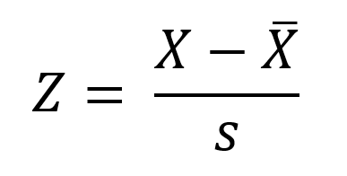
z-score formula

Slide 30
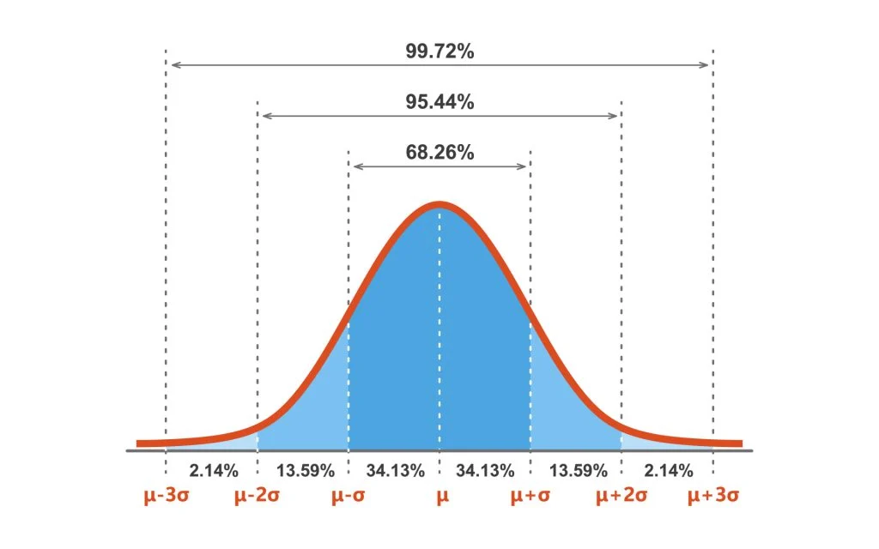
Interpreting Test Scores (4 of 4)
Z-scores can be interpreted as standard deviation units
Notes:
Benefits of z scores:
z Scores offer multiple benefits in terms of interpretation of test scores.
First, z scores can be used to express test scores without the ambiguity that tags along with most psychological measures.
Second, they can be used to compare the scores that come from different sized units.
Third, z scores can be used to study test scores when behavior is measured using instruments like clocks.
An additional interpretive fact:
An important fact about z scores is that it expresses a score in terms of its relation to an entire distribution of scores.
In other words, scores are expressed in relative terms.
However, the z score provides no information in the absolute sense.
For instance, when the z score of a student in an exam is +1, we understand that the student knows the subject more than the average student. But how much more does he know the subject remain unknown.
Important uses of z scores:
While z scores do not express the test score in absolute terms, they are still very helpful in providing a frame of reference that is based on the way scores relate to each other.
They can also be used to conceptualize and compute some important statistical values.
For example, z scores can be used to correlation between two variables such as GPA of a student and the number of hours the student invests in studying.
While both variables are measured in different units, the scores can be converted to z scores and can be studied to draw the correlation between them.
The formula used for computing correlation between variables using z scores is $r_{XY}=\frac{\sum{z_{X}z_{Y}}}{N}$.
Difficulties posed by z scores:
z Scores are not ideal for all purposes and may pose certain difficulties.
First, in the case of negative z scores, measuring variables like intelligence, self-esteem becomes a challenge and may even be objectionable.
Second, some test users and test takers may find it confusing when scores are expressed in fractions or decimals.

Slide 31
Test Norms (1 of 3)
Widely used tests are normed by administering to large groups of people (reference sample)
Scores from sample == norms
  How many participants are needed for norms?
Norms provide a guide but aren’t comprehensive
  Don’t always consider special populations
  Examples?
Notes:
Reference sample and norms of the test:
Widely used tests are generally normed to make their interpretation easier for the users.
The test is usually administered to a large group of people who represent the larger population.
This large group of people are called as reference sample and they are used as a frame of reference for interpreting the other scores.
The scores derived from the reference sample are called “norms” of the test.
Interpretive guides for test users:
Test developers use the appropriate procedures to prepare the interpretive guides for test users.
These guides are used to interpret each new score on the test.
Since test developers have already worked through the conversions and transformations needed to link the new score to a more interpretable score, test use and interpretation has turned out to be more efficient and easier.
Relying on test norms:
From the research perspective, not all test users rely upon the test norms heavily and there are two main reasons to it.
First, the test may be developed for a more specialized research use and therefore it is less likely to have the test developers spend time and effort developing norms and standardized scores in such niche areas.
Second, researchers may lack interest in interpreting individual scores but instead focus on finding associations among variables.
Generally, researchers do not focus on identifying percentile ranks and standardized scores for the specific participants in a study.

Slide 32
Test Norms (2 of 3)
Is the reference sample truly representative?
Who is the target population? Must be well-defined!
Notes:
A truly representative “reference sample”:
The value of normed data depends upon the degree to which the the reference sample truly represents a relevant population.
For the normed data to be useful, the target population must be well defined.
Determining the reference sample:
It can be a complex issue.
Several sampling procedures are used for the same purpose and two of them are discussed below: probability sampling and nonprobability sampling.
By using a probability sampling procedure, one can be assured that the sample represents the target population well.

Slide 33
Test Norms (3 of 3)
Representativeness of the Reference Sample?
  Probability sampling: ensures representative sample.
  Nonprobability sampling: do not produce representative sample.
Notes:
Probability sampling:
It refers to the procedures that ensure a representative sample.
There are different versions of probability sampling such as random sampling, stratified random sampling and cluster sampling.
Nonprobability sampling:
Nonprobability sampling refers to the procedure that do not produce a representative sample.
For instance, picking out the volunteers from a university to form a reference sample for a study may not be representative of all students in the same university.

